Slide 1
Unit 13: Cloud Computing and Storage
AWS and S3

Slide 2
Who is using AWS EC2 and S3?
https://stackshare.io/amazon-s3
https://trends.builtwith.com/cdn/Amazon-S3
https://www.quora.com/Who-are-the-largest-companies-that-use-S3
https://enlyft.com/tech/products/amazon-aws?gclid=Cj0KCQiAiNnuBRD3ARIsAM8Kmlsn_Bwu45nTnzo3YOTYIPXeV679JoSVTzmgWJi1Gn2F_z8vlQkW4bMaAnABEALw_wcB
https://www.infoclutch.com/installed-base/cloud-computing-software/amazon-s3/
https://www.techrepublic.com/pictures/photos-15-high-profile-companies-that-run-on-top-of-amazon-web-services/3/

Slide 3
AWS Case Studies
https://aws.amazon.com/solutions/case-studies/?customer-references-cards.sort-by=item.additionalFields.publishedDate&customer-references-cards.sort-order=desc&awsf.customer-references-location=location%23americas&awsf.customer-references-segment=customer-segment%23enterprise&awsm.page-customer-references-cards=2

Slide 4
Netflix
https://aws.amazon.com/solutions/case-studies/netflix/

Slide 5
Airbnb
https://aws.amazon.com/solutions/case-studies/airbnb-case-study/

Slide 6
Expedia
https://aws.amazon.com/solutions/case-studies/expedia/?pg=CRHuB

Slide 7
Capital One
https://aws.amazon.com/solutions/case-studies/capital-one/

Slide 8
Discussion Questions:
What is your company’s experience with Cloud Computing and Storage?
Does your company allow storage on the cloud?
If not, why do you think they do not?
If so, can you elaborate on any details?
Does your company allow computing on the cloud?
If not, why do you think they do not?
If so, can you elaborate on any details?
Have you personally used AWS / Azure / something else in a work setting?
If so, how?

Slide 9
Competitors / Comparisons
https://www.guru99.com/aws-alternatives-competitors.html
https://www.datamation.com/cloud-computing/aws-vs-azure-vs-google-cloud-comparison.html
https://www.educba.com/aws-vs-azure/

Slide 10
Competitors

Slide 11
Hacks / Security
https://www.cybersecurity-insiders.com/top-5-cloud-security-related-data-breaches/

Slide 12
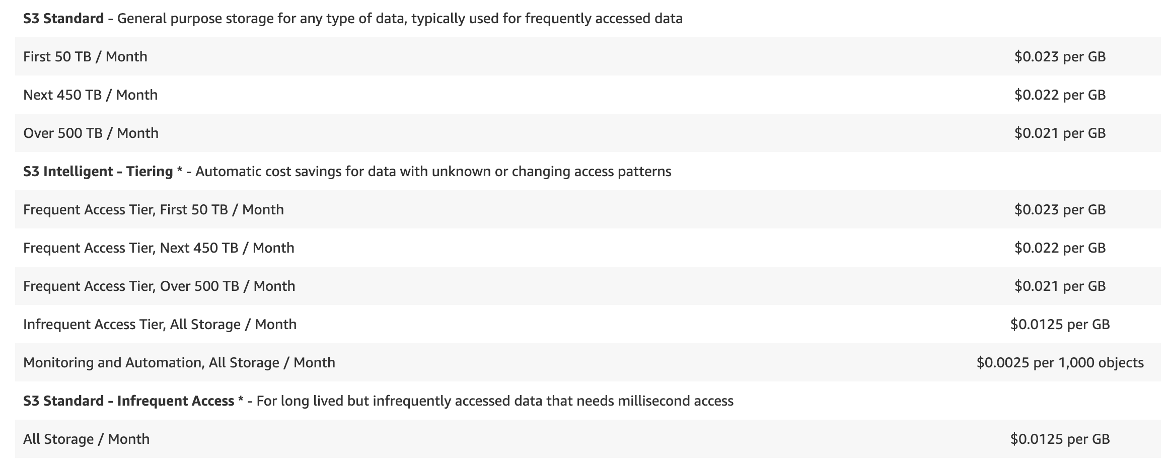
S3 Cost
https://aws.amazon.com/s3/pricing/

Slide 13
EC2 Pricing (In General)
https://aws.amazon.com/ec2/pricing/

Slide 14
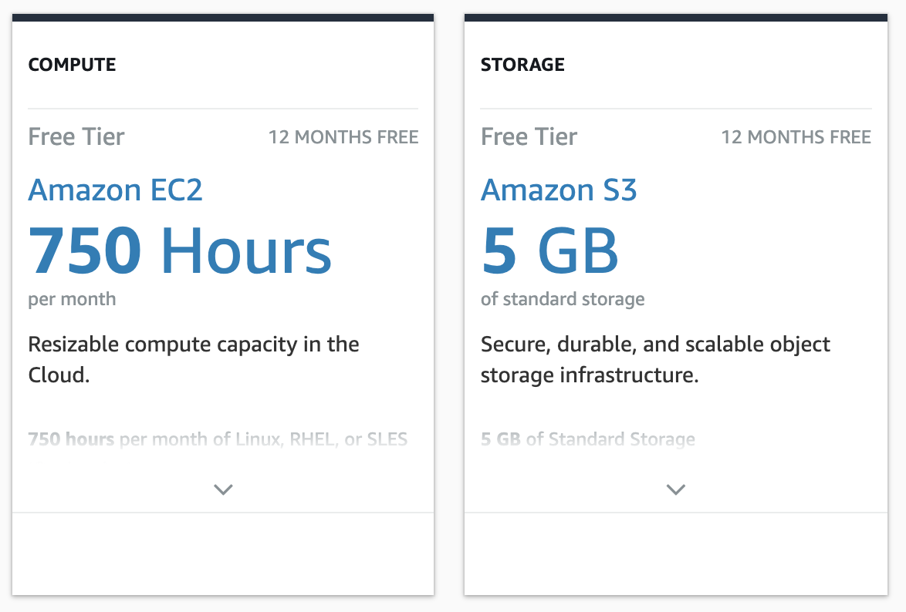
EC2 Pricing (Free Tier)
https://aws.amazon.com/free/?all-free-tier.sort-by=item.additionalFields.SortRank&all-free-tier.sort-order=asc

Slide 15
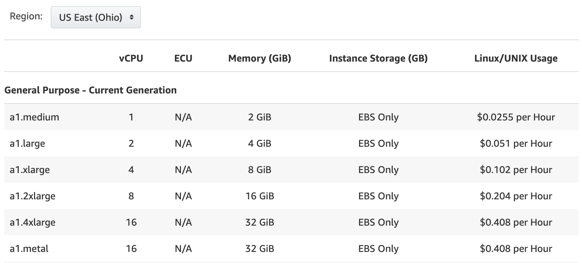
EC2 Pricing
On Demand
https://aws.amazon.com/ec2/pricing/on-demand/

Slide 16
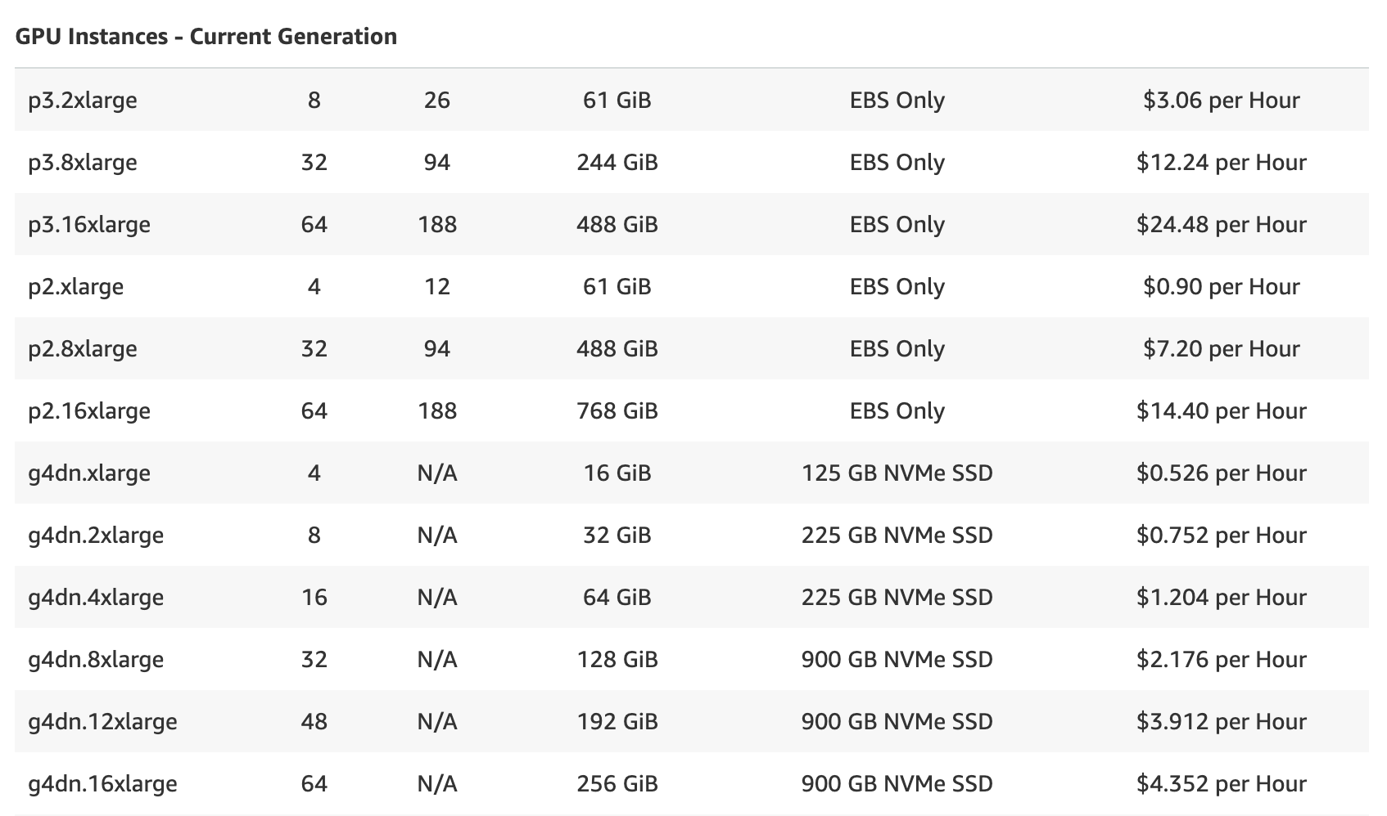
EC2 Pricing
On Demand
https://aws.amazon.com/ec2/pricing/on-demand/

